Slide 1
Population Grid Adaptive Therapy Spelunking
Rafael Bravo, Saanvi Prasad, Mark Robertson-Tessi, Alexander Anderson

Slide 2

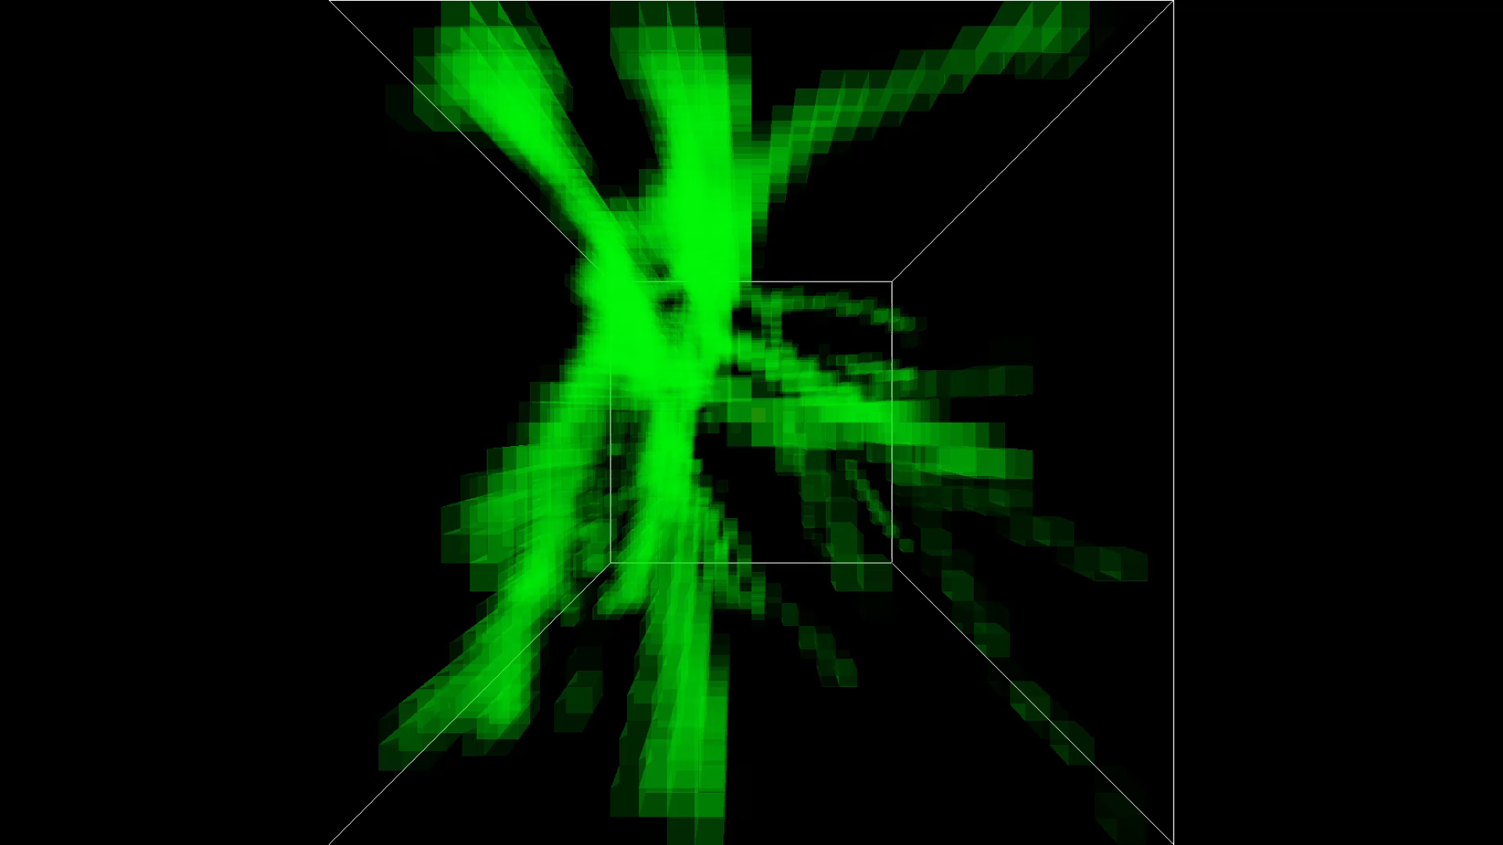

Population grids: A Hybrid Cellular Automata
Turnover
(Binomial)
Migration
(Multinomial)
Tumor
Turnover
(Binomial)
Migration
(Multinomial)
Epithelium

Slide 3
Res
Epithelial
Sen
Resource Dependent Proliferation
Glucose
Drug Kill
Michaelis Menten Consumption
Michaelis Menten Consumption
Drug
Influx
From Blood
Endothelial

Slide 4
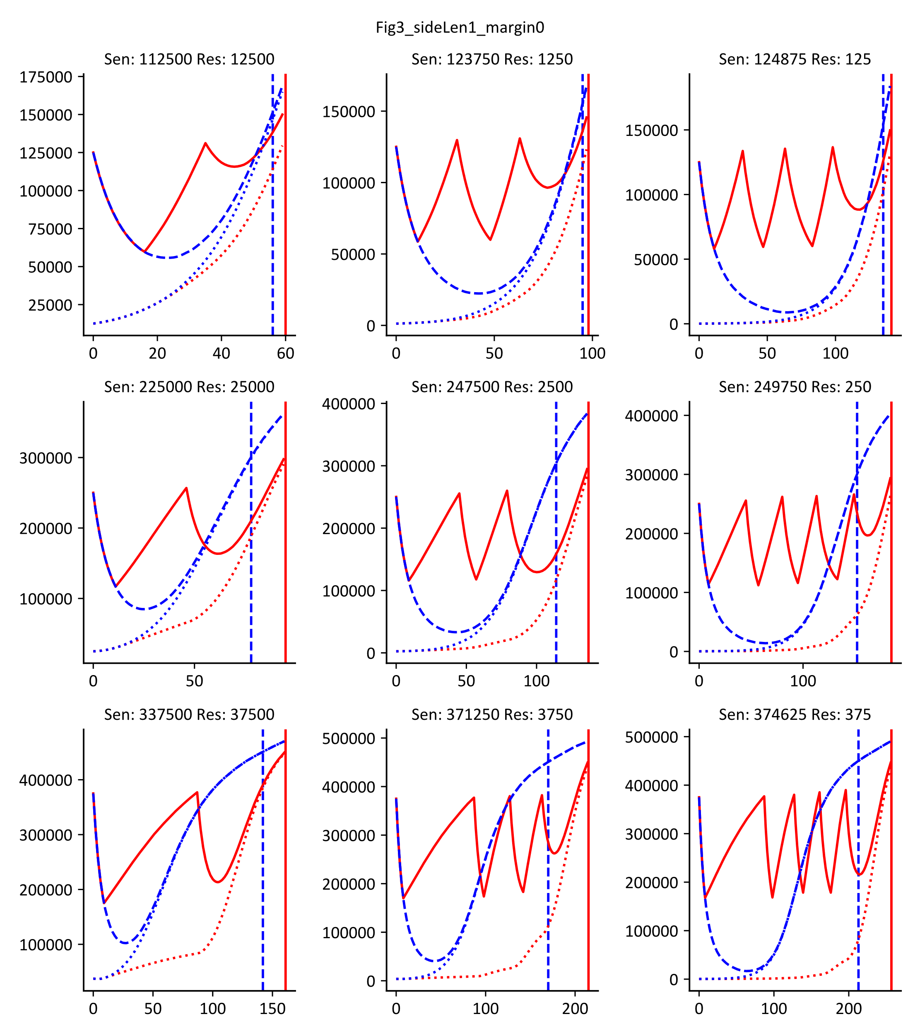

Drug
Res.
Sens.
Adaptive Therapy
Gluc.
Endo
Epi
Drug
Res.
Sens.
Constant Therapy
Gluc.
Endo
Epi

Slide 5
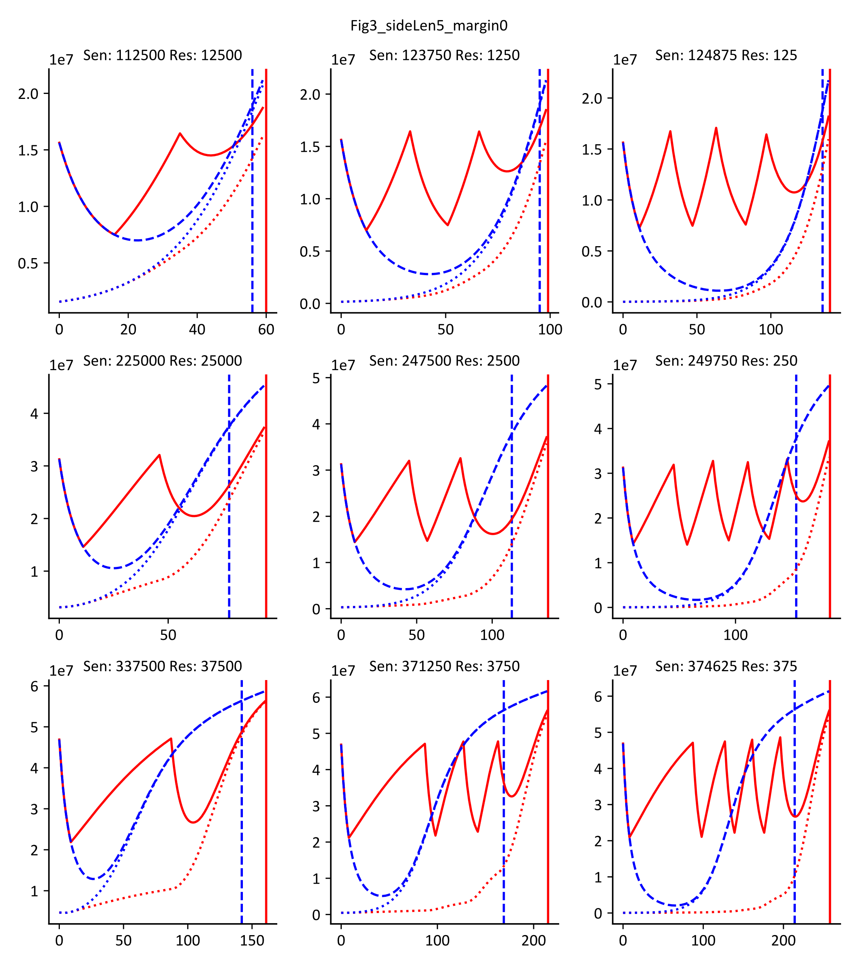
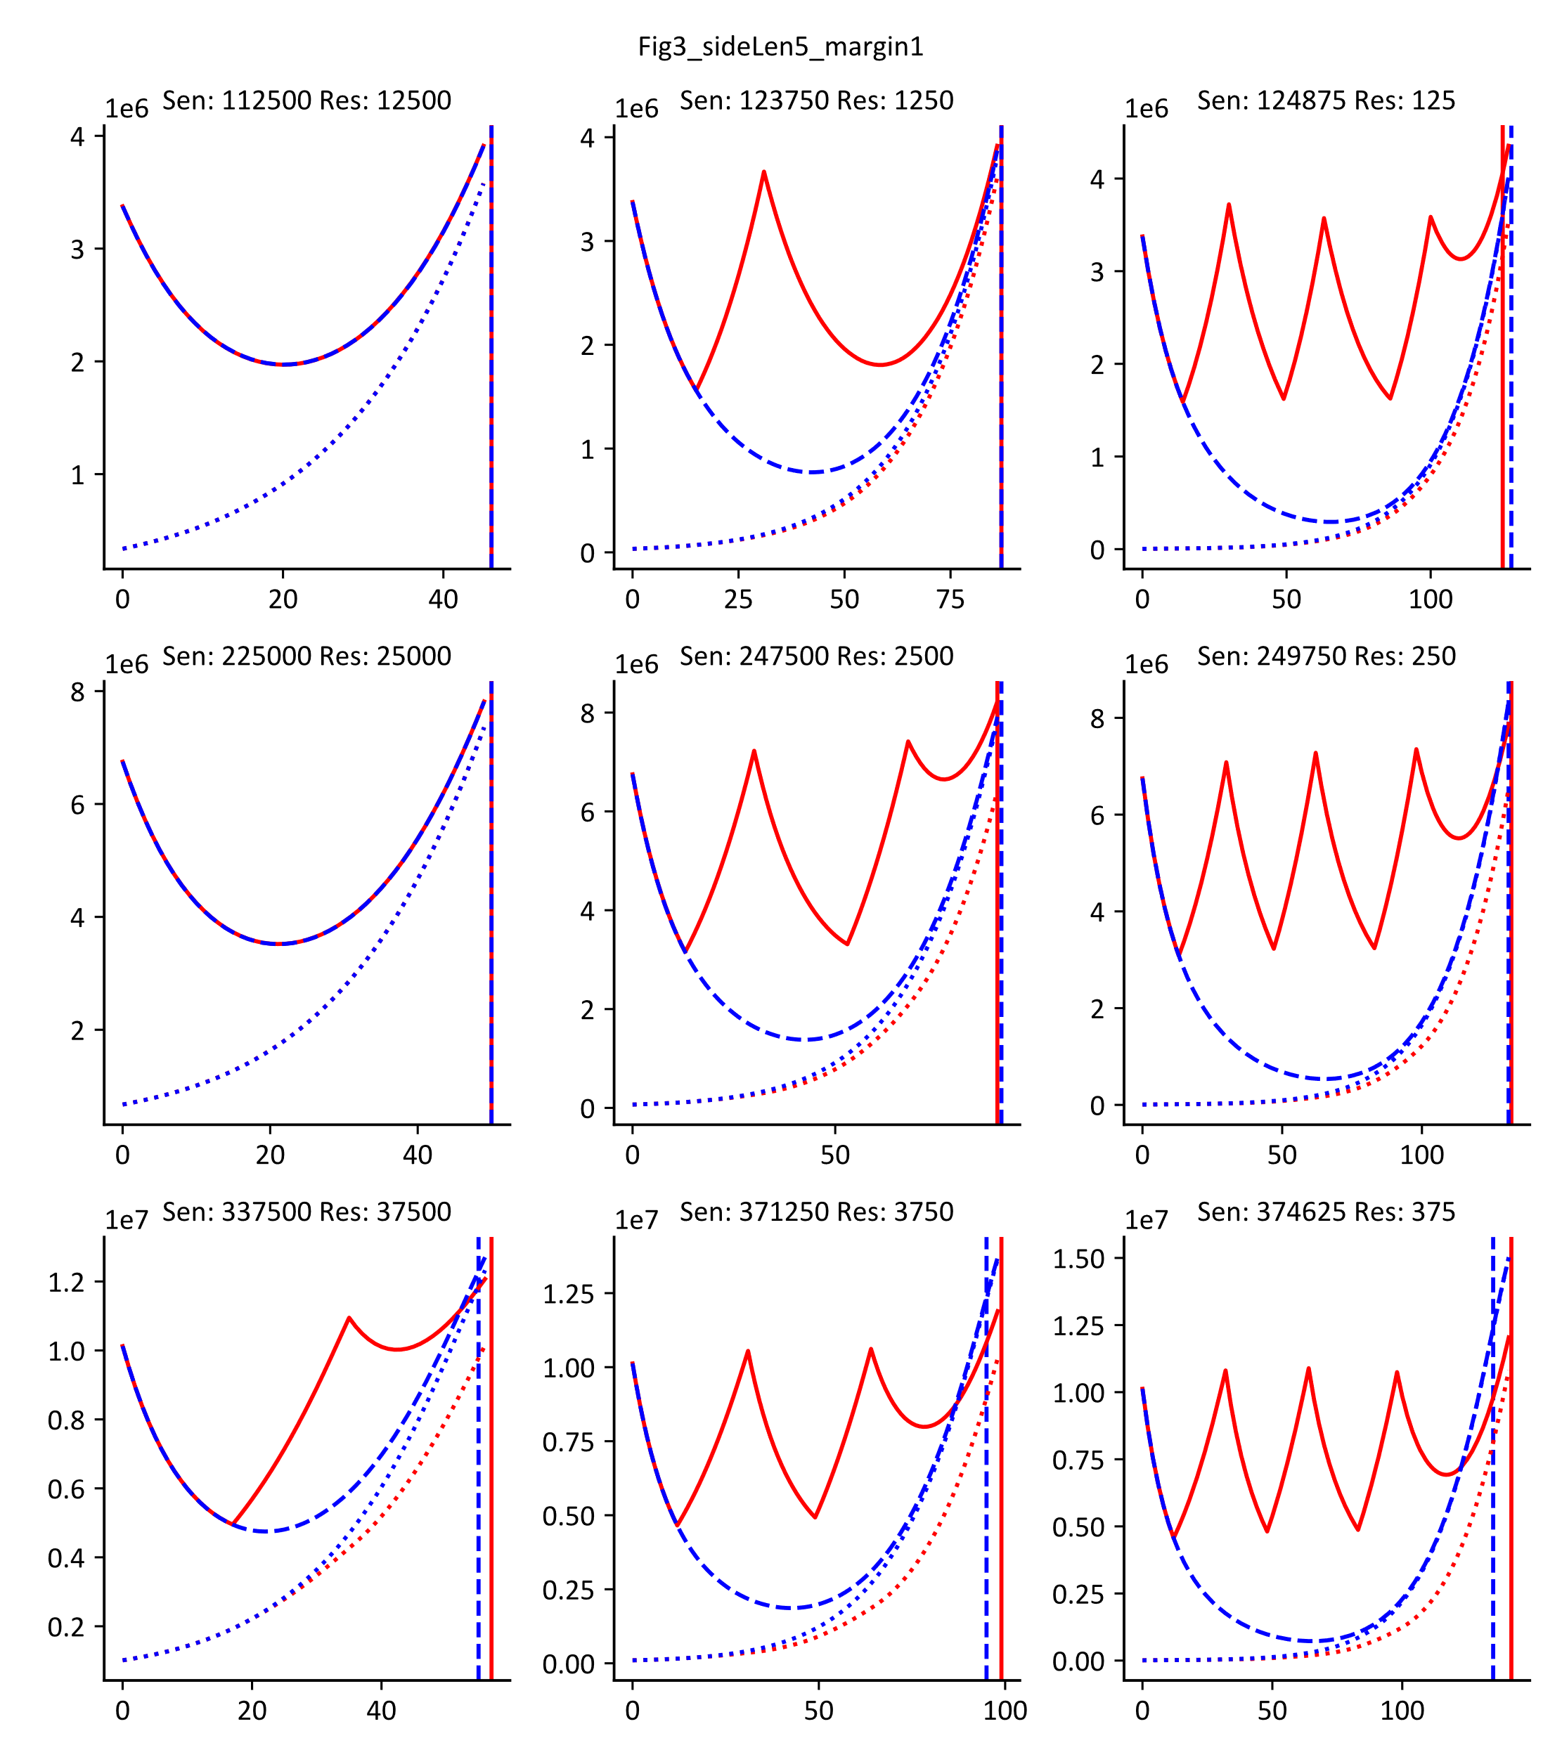
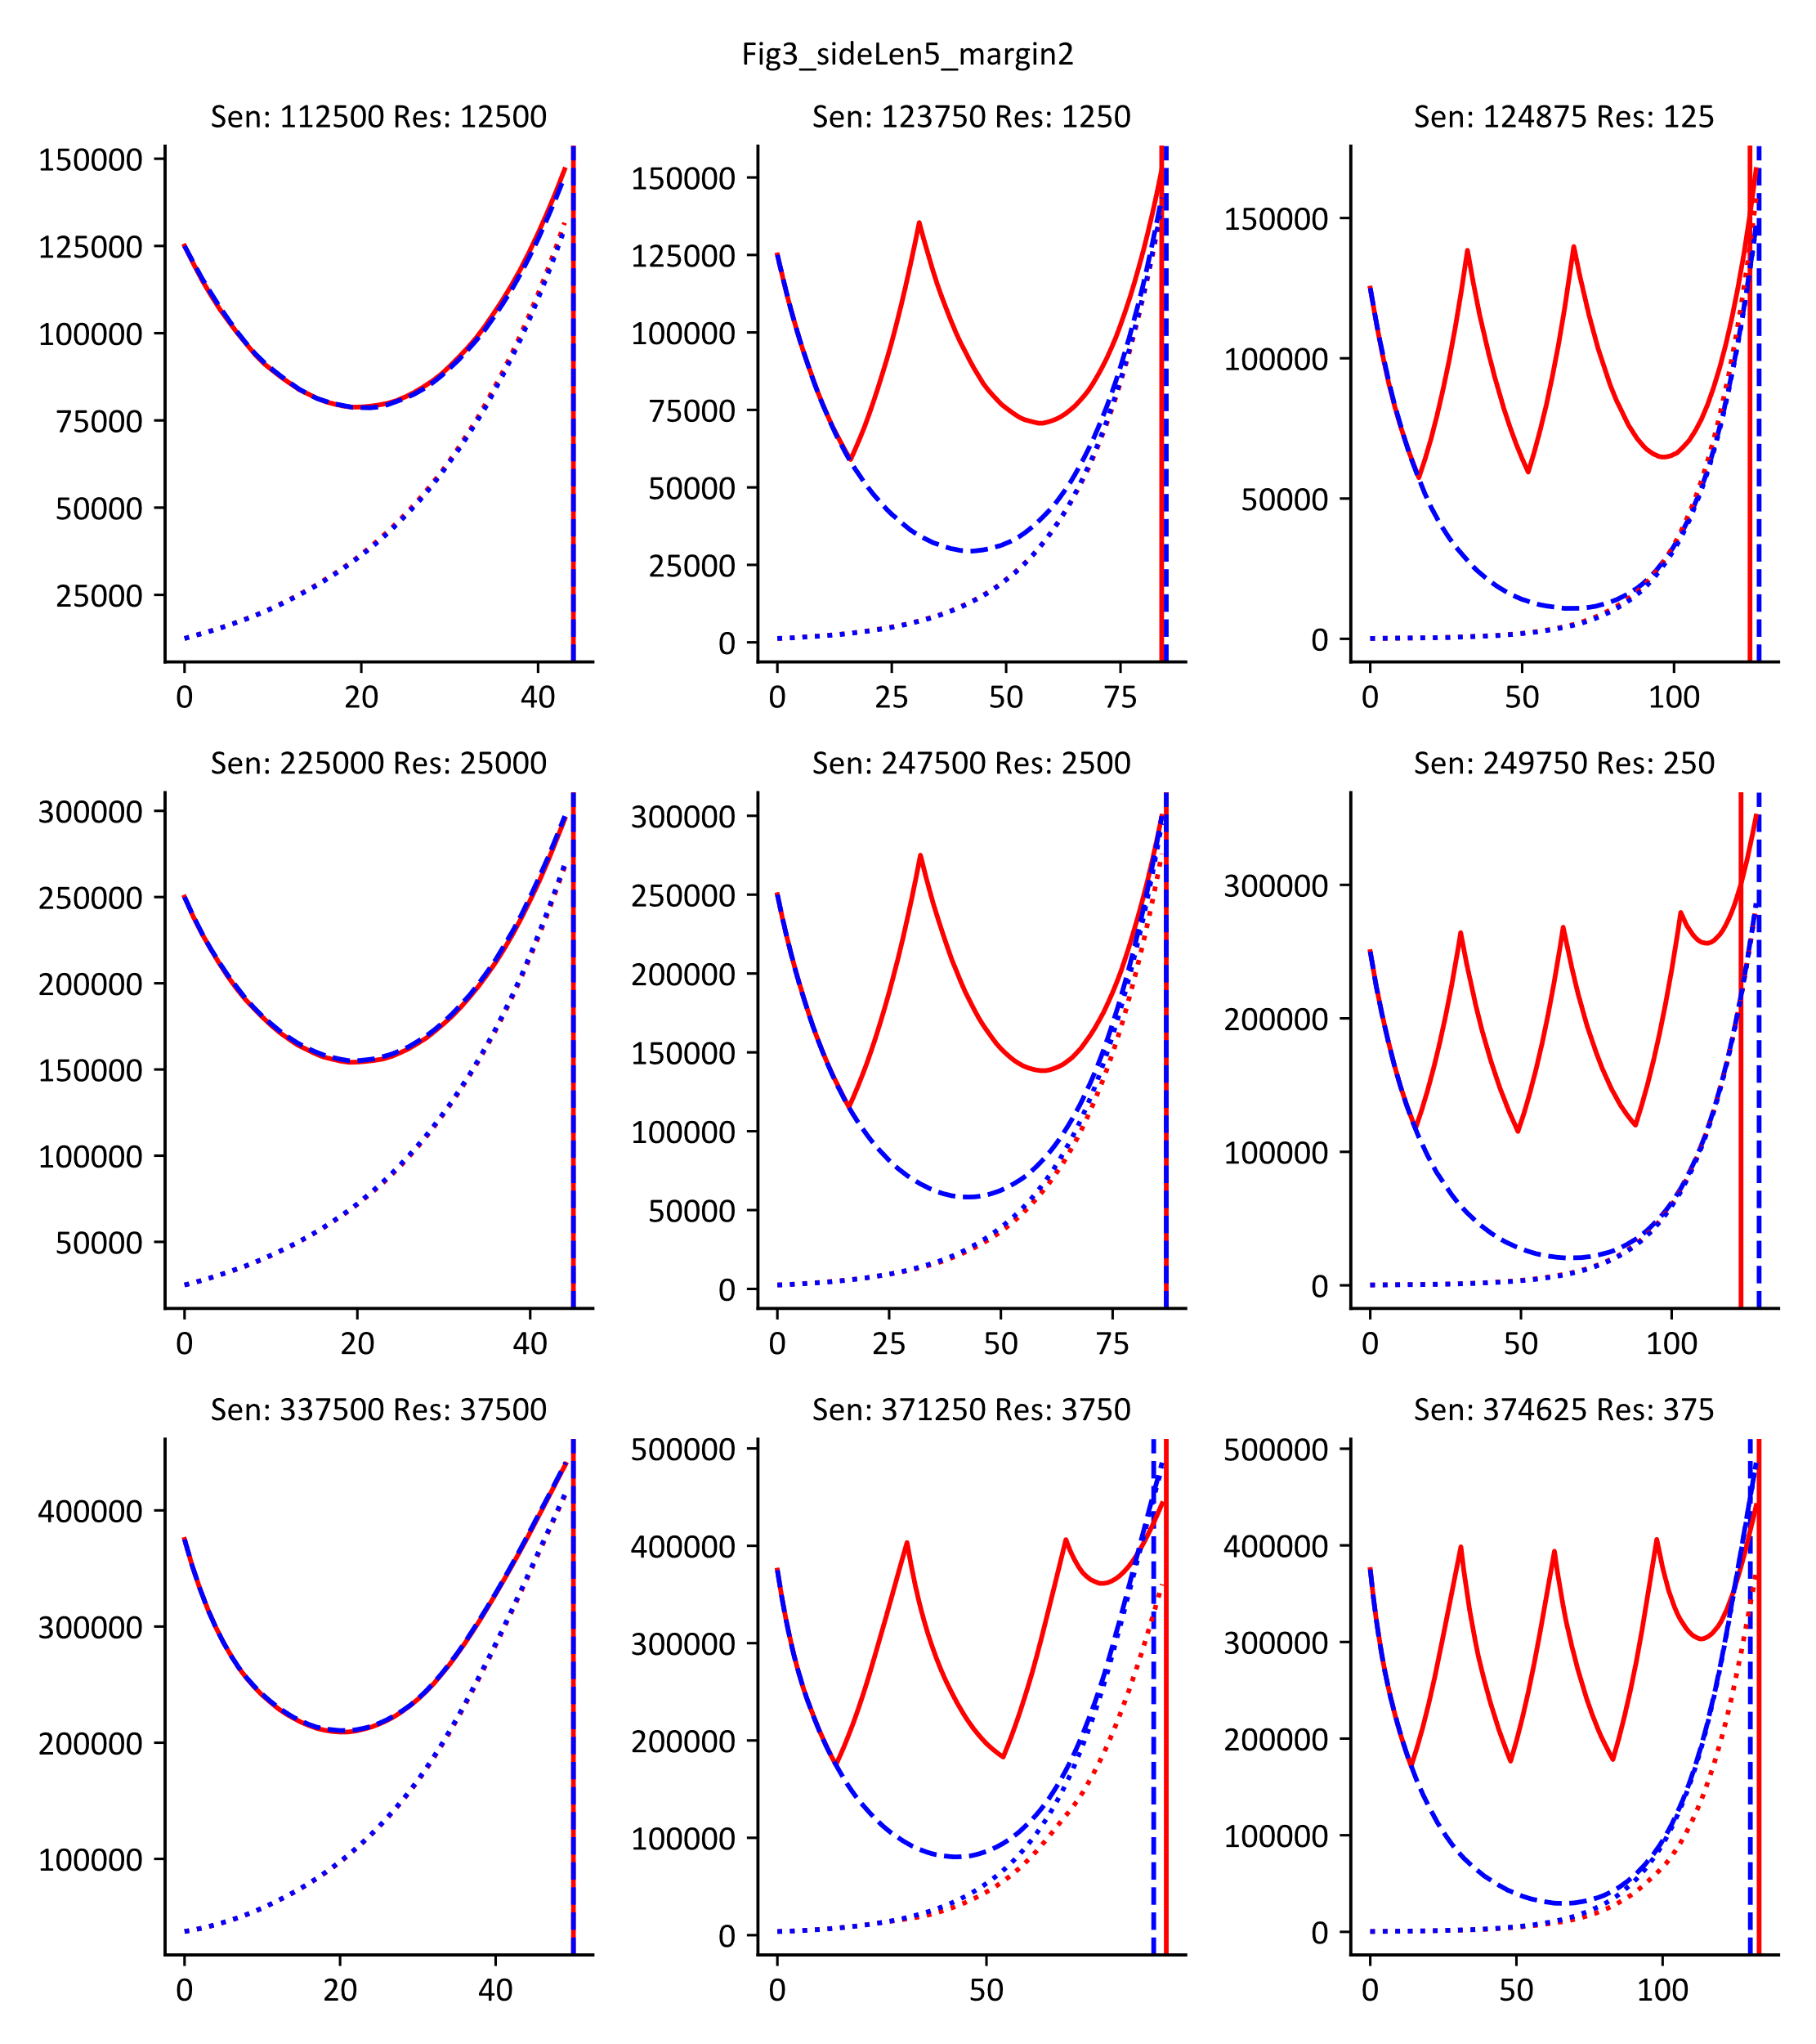

Varying Initial Tumor Margin Affects Outcome

Slide 6
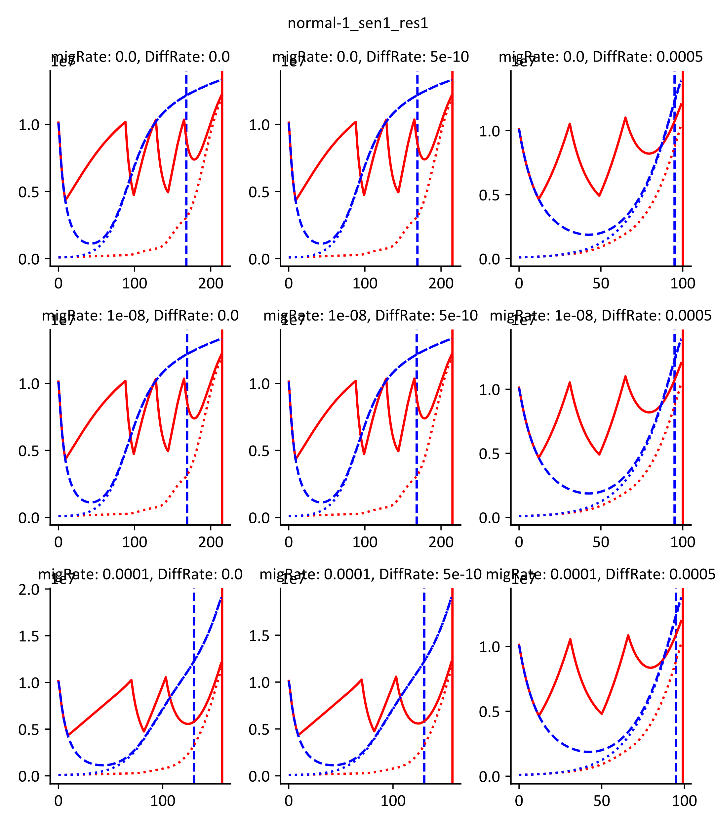
Why Does Varying Margin Affect Outcome?

Slide 7
So when does AT work well in a spatial model?
The key is to use space to enhance AT rather than hinder it: Competitive Release + Drug consumption by tumor

Slide 8
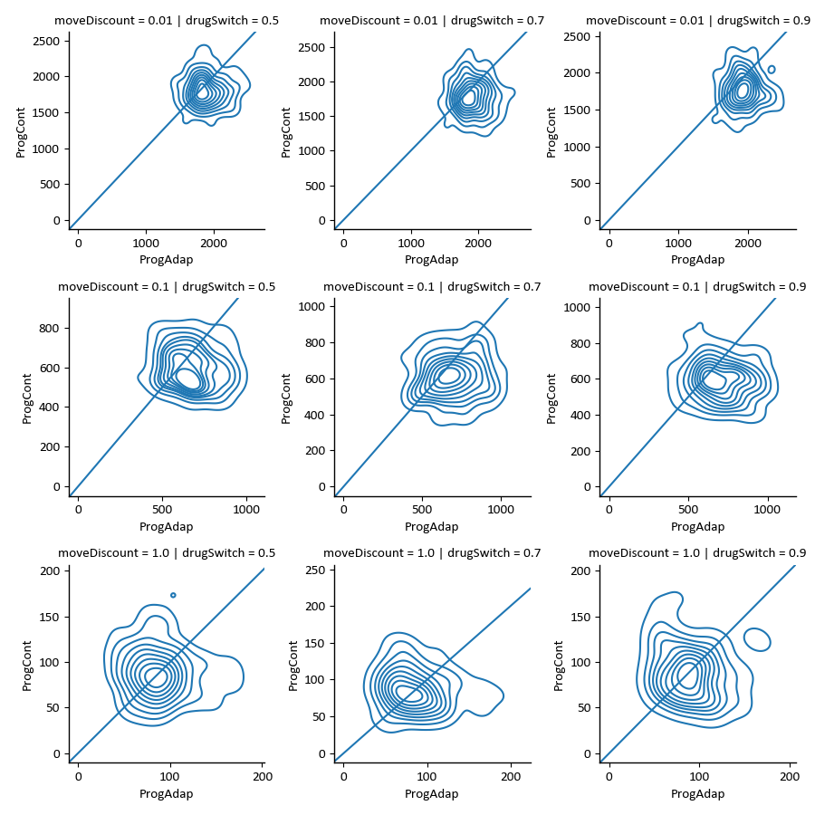
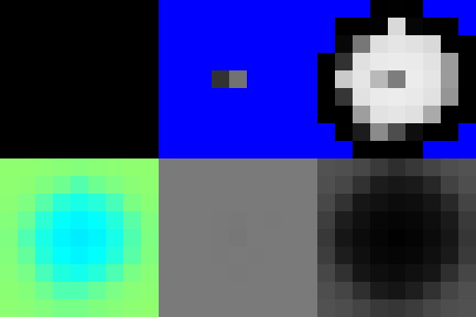
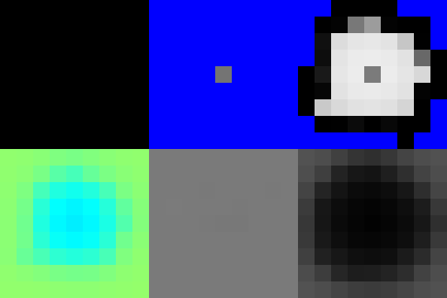
Generate Competitive Release By Slowing Down Resistant Population

Slide 9
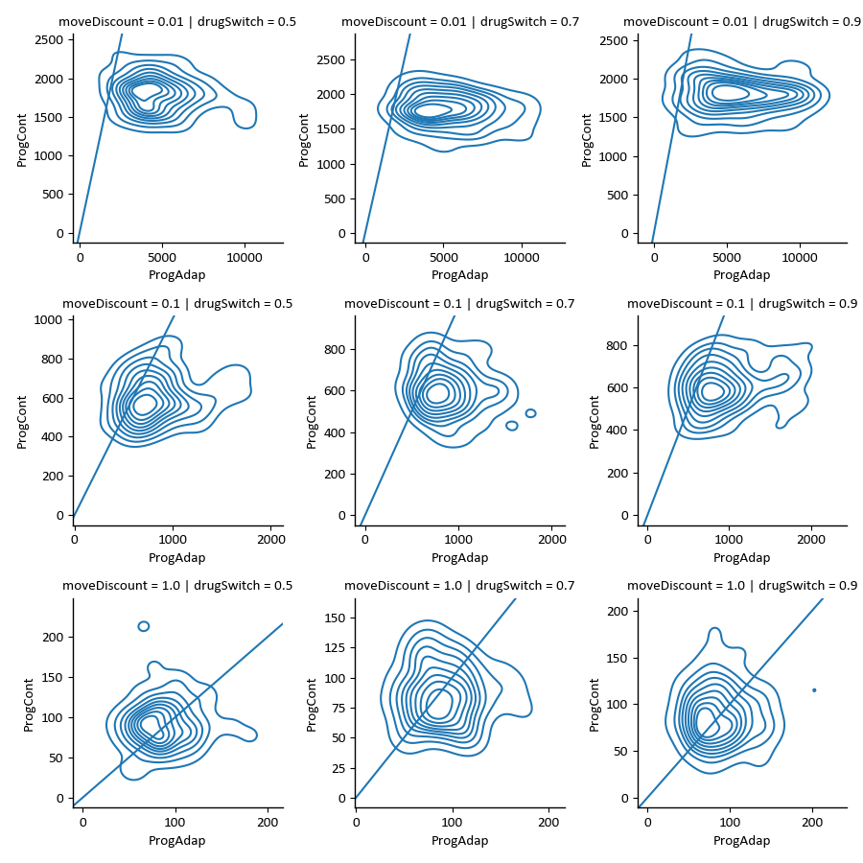
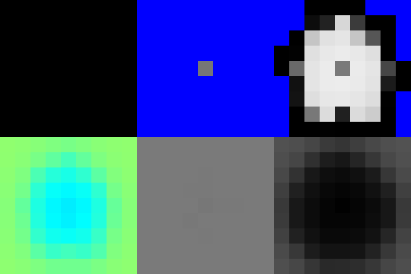
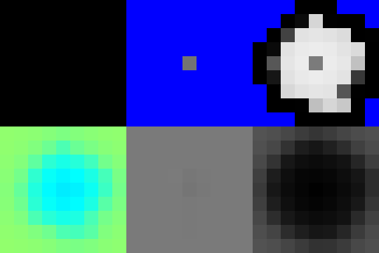
Effect Isn’t Very Well Pronounced, Need Drug Gradient to enhance Competitive Release

Slide 10
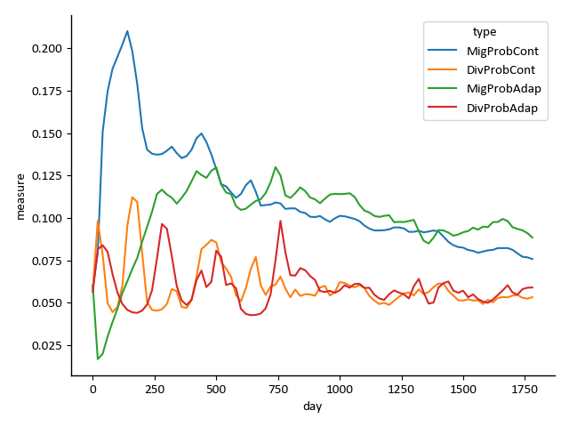
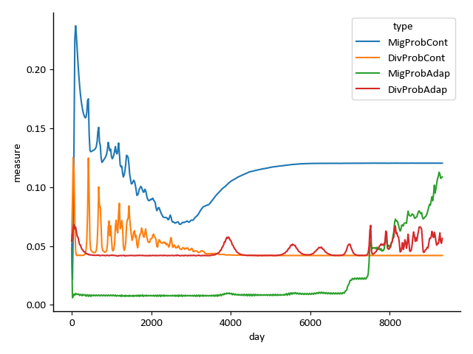
Cell Mind-Reading

Slide 11
Future Directions:
Sweep parameters to see if AT can be effective in a mutation context
Model incremental mutations rather than a fixed sensitive and resistant population
Find relevant imaging data (may not exist)

